Slide 1
Will The ReAL ReST Please Stand Up?

Slide 2




Lee Brandt
Director of Research & Development

Slide 3

What this talk IS
What ReST is
Why ReST?
RMM
Hypermedia
Lots of theory

Slide 4

What this talk ISN’T
ReSTafarian Induction Seminar
Other-Technology Bashing Session
Particularly Serious
As good as you may have been led to believe
Me talking and you listening
GET
POST
DELETE

Slide 5

Who do you think you are?
Programmer of things
Teacher of stuff
Drinker of Beer
Eater of Villagers
Star of Finding Bigfoot
Very Serious
Very Professional
Get Off My Lawn!

Slide 6

Roy Fielding
Notes:
One of the authors of the HTTP Spec
Co-Founder of Apache HTTP Server project
Doctoral Dissertation from 2000

Slide 7

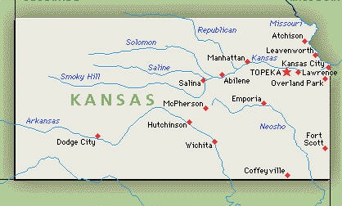
Stateless

Slide 8

Visibility
Notes:
All info about a request is contained in the request

Slide 9

Reliability
Notes:
Makes it easier to recover from partial failures

Slide 10

Scalability
Notes:
Allows server to process the request then move on
No need to worry about storing application state
1 to 4 bajillion clients

Slide 11

Chatty

Slide 12

Developer Brain
DEL
URL
GET
http
PUT
Notes:
people don’t interact that way
“Remember me?” “No.”
Imagine if you had to reintroduce yourself to your family or friends every time you saw them…

Slide 13

Richardson Maturity Model
00 - The Swamp of POX
01 - Resources
02 - HTTP Verbs
03 - Hypermedia
Notes:
Leonard Richardson (I read it through Martin Fowler)

Slide 14

POX
Notes:
RPC
Plain Old XML

Slide 15

Resources
Notes:
Resource
Conceptual target
Resource Identifier
URL/URI/URN for resource
Representation - HTML, JSON, XML, JPEG
Representation Metadata - Last Modified, etc…
Resource Metadata - Source links, etc.
Control Data - Is Cacheable
The Nouns
The stuff people are gonna mess with

Slide 16
HTTP Verbs
HTTP VOY
HTTP VAS
HTTP VA
HTTP VAMOS
HTTP VAN
Notes:
Manipulation of resources through their representations
Using HTTP Verbs
they’re already there

Slide 17

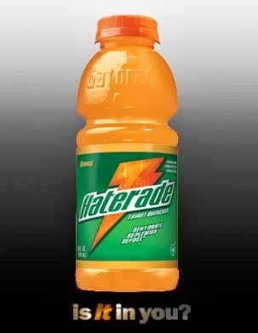
Hypermedia
HATEOAS
Notes:
The real “Secret Sauce” to a great ReSTful platform IMHO
Hypermedia As The Engine Of Application State

Slide 18



Slide 19
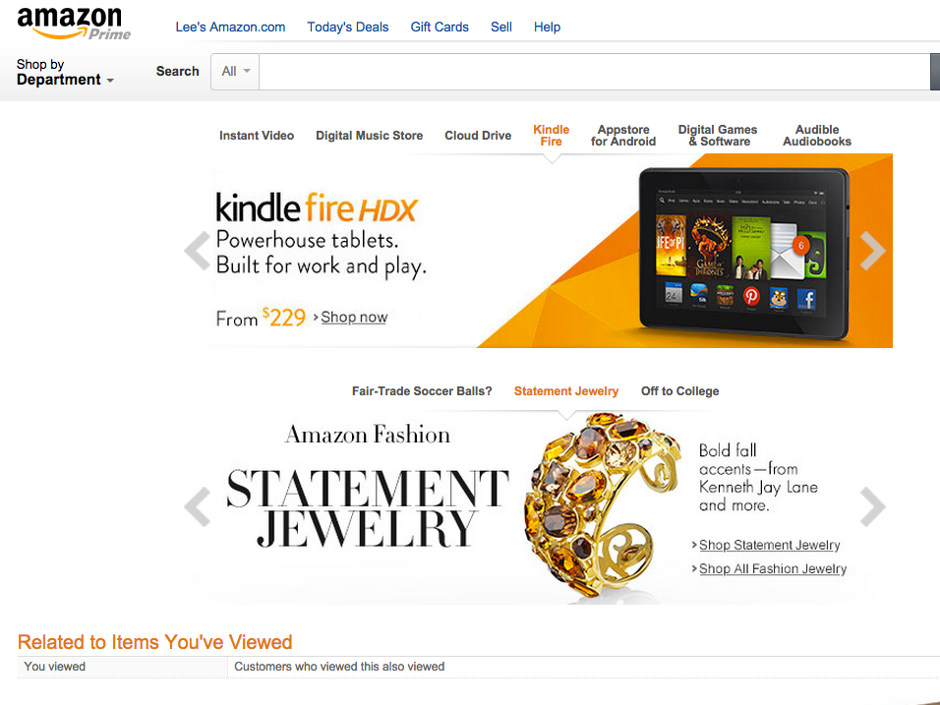

Slide 20
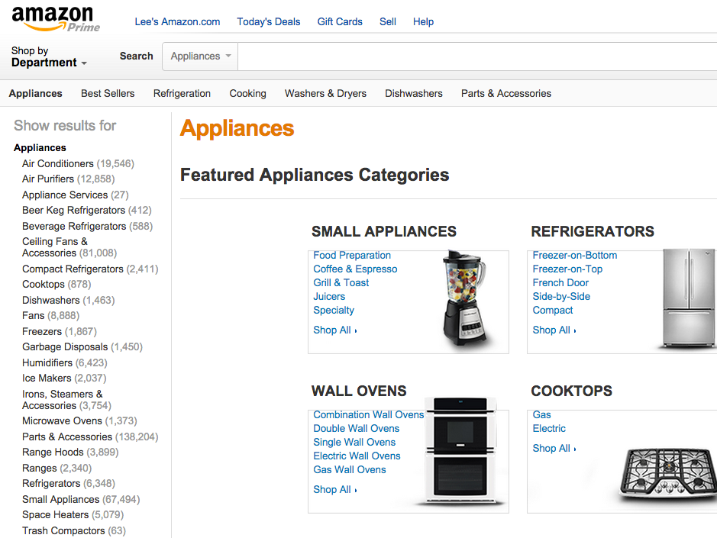

Slide 21
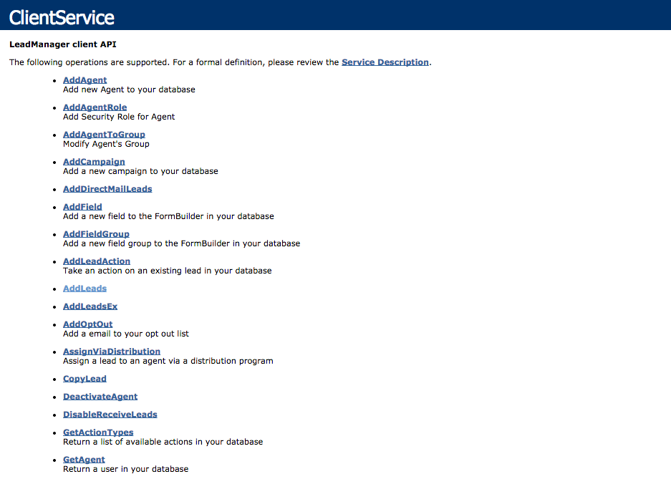

Slide 22
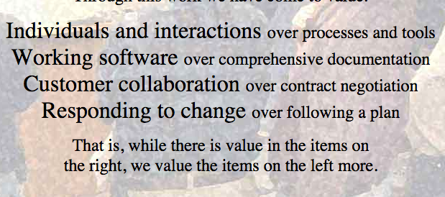

Slide 23
{
apiName: "Conference API",
apiVersion: "1.0",
links: [{
rel: “Sessions”,
href: “http://api.somewhere.com/sessions”
},
{
rel: “Speakers”,
href: "http://api.somewhere.com/speakers"
},
{
rel: “Sponsors”,
href: "http://api.somewhere.com/sponsors"
}]
}

Slide 24
[{
firstName: "Jim",
lastName: "Beam",
location: “Inside us all”,
links: [{
rel: “self”,
href: “http://api2.somewhere.com/speakers/42”
},{
rel: “parent”,
href: “http://api2.somewhere.com/speakers”
}]
sessions: [{
sessionName: "Whisky Deployments”
links: [{
rel: “self”,
href: “http://api2.somewhere.com/sessions/42”
}]
}]
}{
… other speakers …
}]

Slide 25
HAL
(Hypertext Application Language)
JSON API
Siren
Et Al.
Notes:
HAL - http://stateless.co/hal_specification.html
JSON API - http://jsonapi.org/

Slide 26
Cache
Notes:
Pros:
Minimizes chattiness
More efficient
Improves perceived performance
Cons:
More maintenance
Possibly stale data

Slide 27

Violating ReST?!!?

Slide 28

Summary

